Slide 1
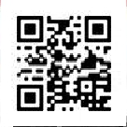
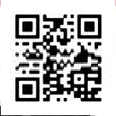
WagePorterage

Slide 2
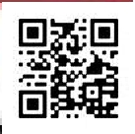
Dear Sirs,
Theactualslumpdoesnotallowyouto,hiremoreemployeesinfullorpartialtime.Theactualneedsaretooshorttomakeit,sothatyouneedanew
system withoutintermediarypeople orcompaniesand conditions.
Wearesatisfiedtotellyouthatsuchsolutioncanbepossiblethankstothewageporterage.Yourpermanentemployeeshavetobeformedpermanently
andevolveaccordingtothetechnology progress.
Consequentlyyouneedsomepeopleforashorttimetoensurethemsuchservices.Wecanteachthemforeignlanguagesinsuchconditions(English,
German,Russian,French,Bulgarian)and make alsotranslations.
Forfurtherinformationdonothesitatetocontactusperemailtothefollowingaddresset_neven@yahoo.fr ortothefollowingphonenumber(+33)
(0)82681 44 04oragain onskypetothefollowingpseudoscheret_laurent orneli.tomova3
You can alsojoin uson the following links :
http://profil.cadremploi.fr/laurent.cheret.1
http://profil.cadremploi.fr/neli.cheret
Clickonlyon« Contact» tosendthe message.
All questions will be treated quickly ,and with discretion.
Best Regards,
All the Teamof ET NEVEN
http://www.cheret.tk
Ourpresentationfilescanbedownloadedonthe followinglinks:
http://hydroculture.monforum.net/upload2/upload_fichier/Presentation_Laurent_CHERET.pdf
http://hydroculture.monforum.net/upload2/upload_fichier/Presentation_Neli_CHERET.pdf

Slide 3
