Slide 1
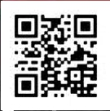
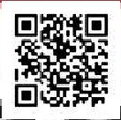
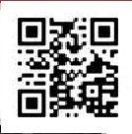
Presentation of the Company
ET NEVEN
Welcome to our Page

Slide 2
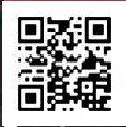
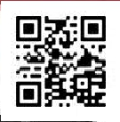

Slide 3
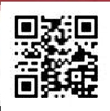
Introduction
The Company ET NEVEN works in partnership with the two following organizations HR Formation & Conseil (SIRET
Number 47953136000028, APE code8559A, Agrement Number41570234957to theheadof the RegionLotharingen)and CADRES
en mission(SIRET Number : 42415167800028, NAF Code7022Z, Agreement Number 52 44 03429 44).
We canpropose you foreign language trainings ans lessons (English,German,Russian,Bulgarian)ingrouplike individually, at home
work, for beginner to advance level .
For further information do not hesitate to contact us per email to the following address et_neven@yahoo.fr
or to the phone number (+33) (0)826 81 44 04 or onskype to the following pseudoscheret_laurent or neli.tomova3
It is also possible to contact us, with the following links :
http://profil.cadremploi.fr/laurent.cheret.1
http://profil.cadremploi.fr/neli.cheret
In the precedent links clickonlyon the button « Contact us »
All aks of information wil be treated with a complete discretion.
Yours Faithfully
All the TeamofET NEVEN
http://www.cheret.tk
Our presentation files can be downloaded onthe following links :
http://hydroculture.monforum.net/upload2/upload_fichier/Presentation_Laurent_CHERET.pdf
http://hydroculture.monforum.net/upload2/upload_fichier/Presentation_Neli_CHERET.pdf

Slide 4
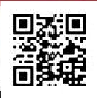
Laurent CHERET's Presentation
Dear Sirs
I ama member of the Company ET NEVEN, thatworks in partnership with thetwo organizations
HRFormation & ConseilHR Formation &
Conseil (SIRET Number 47953136000028, APE code8559A, Agrement
Number415702349 57to thehead oftheRegionLotharingen)and CADRES en mission.SIRET Number : 42415167800028, NAF
Code7022Z, Agreement Number 52 44 03429 44).
I can ensure trainings and professional lessons in English and German, but also translations from English/German toFrench, in group like
individually, at home like directly at work, for beginner to advance level .
For further information do not hesitate to contact us per email to the following address et_neven@yahoo.fr
or to the phone number (+33) (0)826 81 44 04 or onskype to the following pseudo cheret_laurent
All aks of information wil be treated with a complete discretion
Yours Sincerely,
All the Teamof ET NEVEN
http://www.cheret.tk
http://u4itel.info

Slide 5
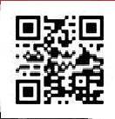
Neli CHERET, born TOMOVA's
Presentation
Dear Sirs
I ama member of the Company ET NEVEN, thatworks in partnership with thetwo organizations
HRFormation & ConseilHR Formation &
Conseil (SIRET Number 47953136000028, APE code8559A, Agrement
Number415702349 57to thehead oftheRegionLotharingen)and CADRES en mission.SIRET Number : 42415167800028, NAF
Code7022Z, Agreement Number 52 44 03429 44).
I can ensure trainings and professional lessons in English and German, but also translations from English/German toFrench, in group like
individually, at home like directly at work, for beginner to advance level .
For further information do not hesitate to contact us per email to the following address et_neven@yahoo.fr
or to the phone number (+33) (0)826 81 44 04 or onskype to the following pseudo neli.tomova3
All aks of information wil be treated with a complete discretion
Yours Sincerely,
All the Teamof ET NEVEN
http://www.cheret.tk
http://u4itel.info

Slide 6
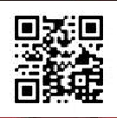
Your Satisfaction is our Job
Dear Sirs,
We propose foreign language trainings andlessons, corresponding to yourneeds and requirements.Also to reach yourobjectives,
except theindividual
lessons ourclass-rooms consist only of 10 people and not more.
A level estimation is realized at the start. An interview is also necessary to estimate your speaking level and also ,to establish your
real
motivations and objectives to reach.
Of course it is important to participate actively during the lessons and to work regularly at home.
We canalso ensure you teachinglessons onskype orin videoconference to allow you to improve your understanding level and reach
the perfect
Of course it is important to participate actively during the lessons and to work regularly at home.
We can also ensure you teachinglessons onskype orin videoconference to allow you to improve your understanding level and reach
the perfect accentuation.
It is also possible to ensure lessons forchildren. Of course the learning means are not the sames forchildrenand adults.As far as
children are concerned educational funteaching means are used to teach foreign languages to children, whereas foradults
andragogical teaching means are used.
Best Regards,
All the TeamofET NEVEN
http://www.cheret.tk

Slide 7
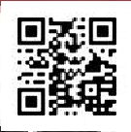
Collaboration Conditions
Dear Sirs,
We aimnot only to satisfy you but alsoto help you and reach your linguistic objectives.
Your lessonscan be paid by yourselves, wether it consistsof private or professional lessons,but alsoby your
company. That can be negotiated, as soonas the lessonsstart.According to the level,student or lessonnumber, the
price can alsobe reviewed. The more you bring us new students, the cheaper your price can be. For instance if you
participate directly to obtain a newstudent for 10 lessonsat least , your price can be reduced.
Whenyoudecidetobesubscribedforlessons, ourpricecontains subscriptiontasks andthefirstlesson,ifyoudecide
not to take directly our package with 10 lessons.
The organization CADRES en missionorders you the lessons.
Best Regards
All the Teamof ET NEVEN
http://www.cheret.tk

Slide 8
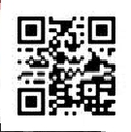
CONTACTS
Dear Sirs,
For further information we are available to give it to you.
Do not hesitate to contact per emailto the electronic addresset_neven@yahoo.fr
or to the phone number (033) (0)826 81 44 04
or on skype to the following pseudoscheret_laurent or neli.tomova3
You can alsocontact usby usingthe following links :
http://profil.cadremploi.fr/laurent.cheret.1
http://profil.cadremploi.fr/neli.cheret
Click on "Contact"
Your Sincerely,
All the Teamof ET NEVEN
http://www.cheret.tk

Slide 9
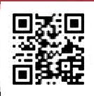
INFORMATION
Do not hesitate to download our free PDF files to the following links :
http://hydroculture.monforum.net/upload2/upload_fichier/Presentation_Laurent_CHERET.pdf
http://hydroculture.monforum.net/upload2/upload_fichier/Presentation_Neli_CHERET.pdf
Thank you very much in advance
Yours Faithfully,
All the Teamof ET NEVEN
http://www.cheret.tk

Slide 10
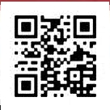
Mission Time
The Company ET NEVEN works in partnership with the twofollowing organizations CADRES en missionand HR
Formation&Conseil.
We work in the frame of wage porterage. The wage porterage consistsof short-timemissionswith well-defined
objectives, purposes,aims.That corresponds perfectly to the needs of mpostof companies, that can not create and
hirefull-timeor short-time contracts. Their needs are in short-timeand clear in the frame of the actual slump. Possibly
itispossibleto worktogoetherinthefuture forseveral short-timemissionsand allmissionsareindependent ones rom
the others.
For further information ,do not hesitate to contact us to the following electronic address et_neven@yahoo.fr or to the
phone number (+33) (0)826 81 44 04 or on skype to the following pseudoscheret_laurent or neli.tomova3
Best Regards
All the Teamof ET NEVEN
http://www.cheret.tk
http://hydroculture.monforum.net/upload2/upload_fichier/Presentation_Laurent_CHERET.pdf
http://hydroculture.monforum.net/upload2/upload_fichier/Presentation_Neli_CHERET.pdf

